Slide 1
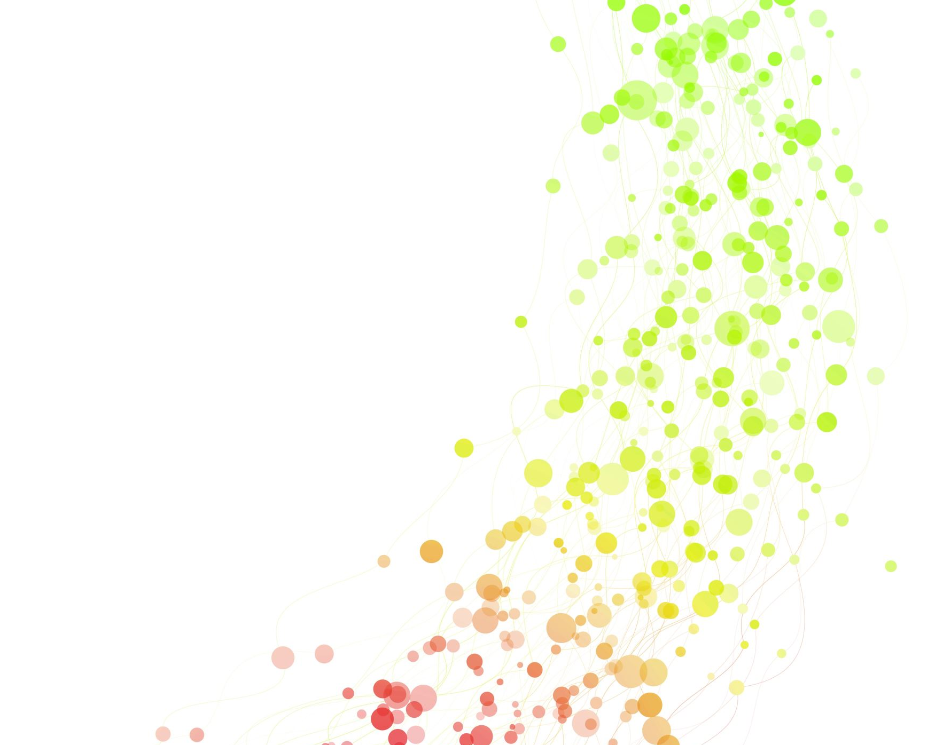
SDLC Fundamentals for Managers

Slide 2
The Modern Project Manager's Role in the Cycle
The modern PM has shifted from an administrative task-tracker using rigid Gantt charts to a
value delivery facilitator
risk orchestrator, and
process integrator.
When blending Agile delivery with CMMI standards, the PM acts as the bridge between team-level execution (sprints, standups, backlogs) and organizational process governance (audit trails, measurement analysis, process compliance). Instead of commanding tasks, modern PMs remove impediments, track flow metrics (lead time, velocity, escaped defects), and ensure CMMI process performance baselines are maintained without slowing the team down.

Slide 3
Waterfall vs. Agile vs. Hybrid Delivery Models
Traditional Waterfall is linear and phase-gated—best suited for safety-critical, low-uncertainty initiatives where upfront specifications are legally binding. Agile prioritizes rapid user feedback, iterative design, and adaptive planning—ideal for market uncertainty and evolving digital products. Hybrid models bring together the governance required by frameworks like CMMI (formal milestone reviews, requirements traceability, and quantitative project management) with iterative two-to-four-week Agile sprints.

Slide 4
Waterfall vs. Agile vs. Hybrid Delivery Models
Attribute | Waterfall | Agile (Scrum/Kanban) | Hybrid (Agile + CMMI)
Requirements | Fixed upfront; change via CCB | Emergent, backlog-driven | Base capability documented; sprints detail UI/features
Delivery | Single Big-Bang release | Incremental shippable increments | Staged releases with sprint increments
Compliance & Traceability | High, post-phase sign-offs | Lightweight, informal | Automated, tool-backed traceability (Jira/Confluence)
Risk Management | Front-loaded analysis, late validation | Continuous, empirical validation | Early architectural spikes + formal CMMI DAR

Slide 5
The "Shift-Left" Mentality in Risk Management and QA
"Shift-Left" moves testing, security checks, and risk analysis to the earliest stages of the SDLC rather than leaving them before deployment.
Under CMMI (specifically Verification, Validation, and Risk Management process areas), defects caught during initial requirement drafting cost significantly less to fix than post-release bugs.
In an Agile setup, shifting left translates to static code analysis, early test automation (TDD/BDD), continuous security scanning (DevSecOps), and cross-functional user story refinement.

Slide 6
Overview of Standard SDLC Phases and Stage Gates
Even within iterative cycles, standard lifecycle phases persist:
Conception/Inception
Requirements Analysis
Architectural Design
Construction/Implementation
Verification & Validation (QA), and
Deployment/Transition.

Slide 7
Overview of Standard SDLC Phases and Stage Gates
In an Agile + CMMI environment, stage gates evolve from bureaucratic documentation halts into objective, metric-driven transition criteria:
Gate 1: Definition of Ready (DoR) — Ensures user stories have testable acceptance criteria, dependencies mapped, and CMMI traceability IDs.
Gate 2: Sprint Review & Definition of Done (DoD) — Validates unit tests, code reviews, and static analysis thresholds.
Gate 3: Release Readiness Review — Formally reviews non-functional requirements, compliance, sign-offs, and rollback plans before production deployment.

Slide 8

CMMI Fundamentals for Project Managers

Slide 9
Introduction to Capability Maturity Model Integration (CMMI)
CMMI is a process and behavioral model that helps organizations streamline process improvement and encourage productive, efficient behaviors that decrease risks in software, product, and service development. Rather than prescribing a rigid daily routine, CMMI establishes "what" must be achieved (process capability and measurable outcomes), leaving the "how" (tactical execution via Scrum, Kanban, or XP) up to the organization.

Slide 10
Understanding Maturity Levels (1–5) and Project Governance
CMMI evaluates organizational maturity across five distinct evolutionary tiers. For project managers, each level dictates the degree of predictability, repeatability, and control available to govern scope, cost, and schedule:

Slide 11
Level | Focus | Governance & Project Behavior
Level 1: Initial | Unpredictable & Reactive | Work gets done, but processes are ad hoc, heroic, and chaotic. Success depends entirely on individual rockstars; budgets and schedules routinely slip.
Level 2: Managed | Project-Level Discipline | Basic project management is institutionalized. Requirements are managed, work is planned, monitored, and controlled, and work products meet baselines at the project level.
Level 3: Defined | Organizational Standards | Standards, process descriptions, and procedures are tailored from an organization-wide standard library. Cross-project consistency, peer reviews, and formal risk governance take hold.
Level 4: Quantitatively Managed | Data-Driven & Statistical | Processes are controlled using statistical and quantitative techniques. PMs use process performance baselines and models to predict cost, schedule, and quality outcomes.
Level 5: Optimizing | Continuous Innovation | Focus on continuous process improvement based on quantitative understanding of business objectives. The organization proactively isolates and addresses common causes of defects.

Slide 12
Mapping CMMI to SDLC Phases and Stage Gates
CMMI maps cleanly into SDLC phases by attaching specific verification, review, and governance expectations to technical deliverables:

Slide 13
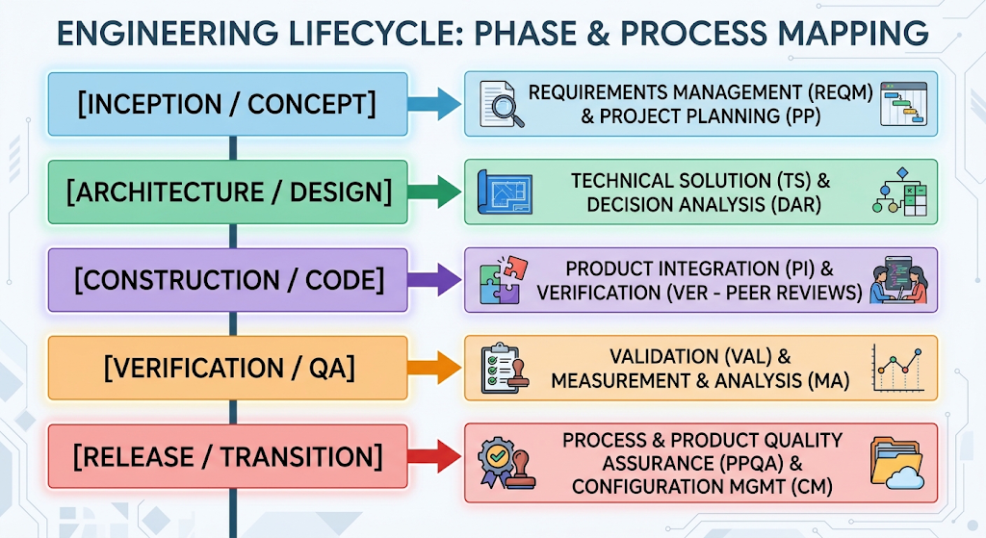

Slide 14
Mapping CMMI to SDLC Phases and Stage Gates
In an Agile setting, these gates become objective sprint checkpoints:
Pre-Sprint Gate: REQM + PP (Backlog refinement and sprint planning against team capacity).
Mid-Sprint Gate: TS + VER (Automated linting, paired programming, and peer pull requests).
Release Gate: CM + VAL + DAR (Regression pass rate, automated deployment manifests, and sign-offs).

Slide 15
Strengthening Planning, Estimation, Risk Management, and Stakeholder Alignment
Planning & Estimation (PP / MA): CMMI replaces intuitive "gut-feel" guessing with estimation models backed by historical performance data (e.g., historical velocity, story point complexity vs. defect leakage).
Risk Management (RSKM): Rather than passive risk logs that collect dust, CMMI enforces continuous risk parameter identification, categorizing likelihood/impact, setting explicit mitigation triggers, and tracking residual risk.
Stakeholder Alignment (CAR / DAR / Governance): Mandates structured involvement of relevant stakeholders through objective evaluations (DAR) and scheduled cadence reviews, removing subjective politics from critical technical decisions.

Slide 16
Integrating CMMI with Agile, Scrum, and Hybrid Delivery Models
CMMI and Agile are complementary, not competing. Agile provides the speed, customer touchpoints, and empirical adaptation, while CMMI provides the institutional memory, repeatability, and quality guarantees.

Slide 17
Integrating CMMI with Agile, Scrum, and Hybrid Delivery Models
Backlog Grooming = Requirements Management (REQM): Epics and user stories with acceptance criteria fulfill CMMI requirements derivation and change control.
Retrospectives = Causal Analysis and Resolution (CAR): Sprints inherently inspect and adapt, creating continuous improvement loops required by higher maturity levels.
Burndown / Velocity Charts = Measurement & Analysis (MA): Team telemetry provides the objective quantitative metrics CMMI auditors look for, eliminating the need for parallel manual tracking.

Slide 18

Agile & Scrum for Project Managers

Slide 19
Navigating Sprints, Daily Stand-Ups, and Retrospectives
For a PM working under a CMMI-aligned governance model, Agile ceremonies serve as objective operational checkpoints rather than mere calendar invites:
Sprint Planning: Establishes the Sprint Goal and sets the operational commitment baseline. For CMMI, this aligns directly with Project Planning (PP), ensuring the team commits only to work matched against empirically proven capacity.
Daily Stand-Up: A 15-minute synchronization focused on flow, coordination, and blockers (not status reporting to the PM). The PM uses this ceremony to spot emerging risks, cross-team impediments, and process friction early.
Sprint Review: A working software demonstration with stakeholders that acts as the primary Agile validation event (Validation - VAL in CMMI).
Sprint Retrospective: The team inspects its own processes, people, and tools. Under CMMI Level 3–5, retrospectives map to Causal Analysis and Resolution (CAR) and continuous process improvement—where systemic impediments are converted into actionable backlog improvements.

Slide 20
Translating Business Requirements into Epics and User Stories
Bridging enterprise stakeholders and development teams requires deconstructing ambiguous business vision into granular, verifiable technical increments:
Epics: High-level strategic initiatives or business capabilities that span multiple sprints (e.g., "Automated Multi-Currency Billing Engine").
User Stories: Vertical, testable slices of end-user value written in the standard format:
“As a [role], I want [action], so that [business value].”
INVEST Criteria: Stories must be Independent, Negotiable, Valuable, Estimable, Small, and Testable.
CMMI Traceability Link: In Jira/Confluence, every User Story must link upstream to an Epic/Business Requirement and downstream to Acceptance Criteria and Test Cases (Requirements Management - REQM).

Slide 21
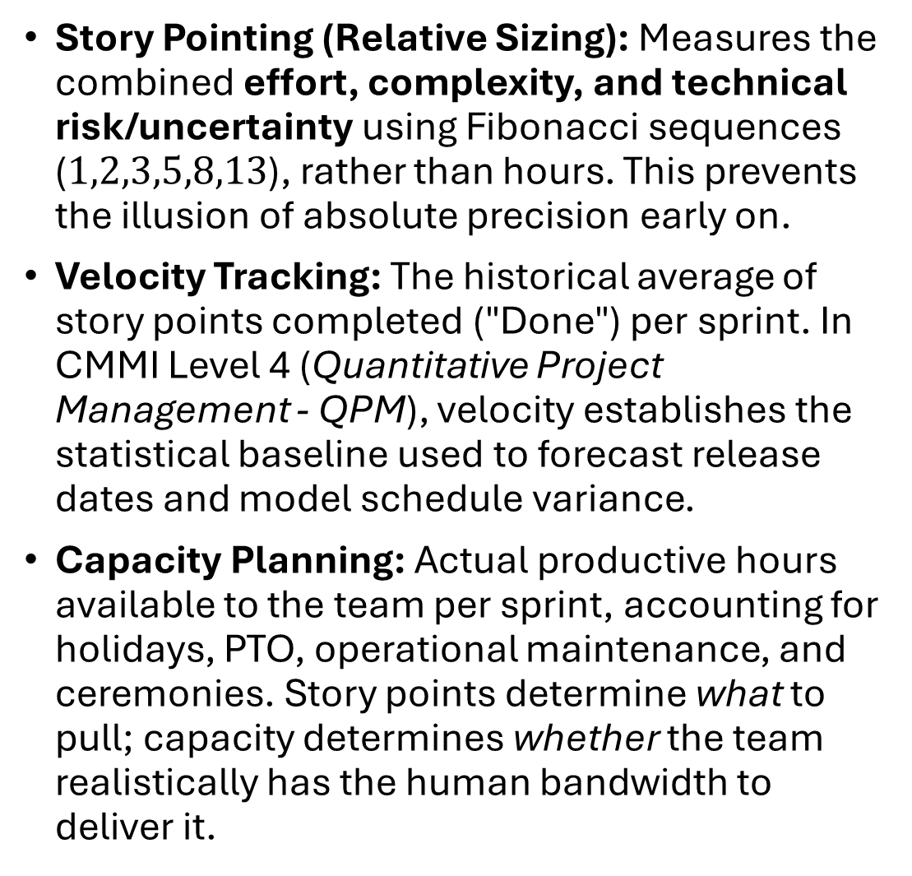
Velocity Tracking, Story Pointing, and Capacity Planning
Story Pointing (Relative Sizing): Measures the combined effort, complexity, and technical risk/uncertainty using Fibonacci sequences ($1,2,3,5,8,13$), rather than hours. This prevents the illusion of absolute precision early on.
Velocity Tracking: The historical average of story points completed ("Done") per sprint. In CMMI Level 4 (Quantitative Project Management - QPM), velocity establishes the statistical baseline used to forecast release dates and model schedule variance.
Capacity Planning: Actual productive hours available to the team per sprint, accounting for holidays, PTO, operational maintenance, and ceremonies. Story points determine what to pull; capacity determines whether the team realistically has the human bandwidth to deliver it.

Slide 22

Requirement Gathering and Analysis

Slide 23
Collaborating with Stakeholders to Identify Edge Cases Early
Requirement defects caught post-deployment cost up to 100 times more to fix than those discovered during initial discovery.
In an Agile + CMMI environment, requirement gathering bridges continuous customer interaction with structured rigor (Requirements Development - RD and Requirements Management - REQM):

Slide 24
Collaborating with Stakeholders to Identify Edge Cases Early
Beyond the "Happy Path": Business stakeholders naturally focus on primary success workflows. Project managers must facilitate discovery sessions using structured techniques (such as Event Storming, User Story Mapping, and Example Mapping) to draw out negative flows, concurrency conflicts, system failure modes, and regulatory boundaries.
Specification by Example (BDD): Formulating acceptance criteria using Given-When-Then (Gherkin syntax) forces stakeholders and developers to clarify edge cases before engineering begins (e.g., handling expired payment tokens, conflicting concurrent bookings, or partial network timeouts).
Early Defect Prevention: Under CMMI Level 3, peer reviews of requirements are as critical as peer reviews of code. Catching ambiguities, unstated assumptions, and missing validation rules early ensures stories meet the Definition of Ready (DoR).

Slide 25
Defining the Minimum Viable Product (MVP) and Release Phases
An MVP is frequently misunderstood as a rushed, low-quality version 1.0. In disciplined product development, an MVP is the smallest functional increment that delivers end-user value and validates critical business assumptions while meeting production-grade quality baselines.

Slide 26
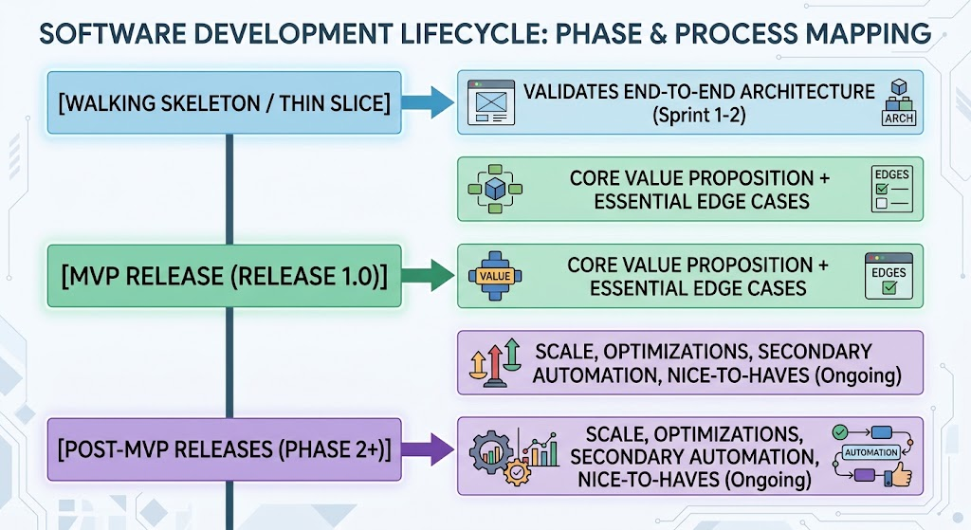

Slide 27

Defining the Minimum Viable Product (MVP) and Release Phases
The "Thin Slice" Approach: Instead of building a full horizontal layer (e.g., all database schemas first, then all APIs, then UI), the MVP cuts vertically through the entire stack for a single user journey.
MoSCoW & Value vs. Effort Prioritization: Teams slice user stories into Must-Have, Should-Have, Could-Have, and Won't-Have (this release). The MVP consists strictly of Must-Haves.
CMMI Baselines in Release Phasing: While Agile allows flexible scope inside future releases, CMMI requires that each planned release candidate has an approved scope baseline, a verified configuration audit trail, and an agreed-upon release acceptance threshold.

Slide 28

Risk Management & Technical Debt

Slide 29
Identifying and Prioritizing Project and Technical Risks
In an Agile + CMMI environment, risk management moves away from passive, static spreadsheets updated only before audits to an active, continuous feedback loop integrated directly into the sprint lifecycle:

Slide 30
Identifying and Prioritizing Project and Technical Risks
Taxonomy of Delivery Risk: Risks divide into project/operational risks (vendor dependency delays, budget variance, resource turnover) and technical risks (architectural scalability limits, third-party API rate limits, security vulnerabilities, legacy system coupling).
CMMI Risk Management (RSKM): Level 3 mandates structured identification, evaluation of probability and impact, threshold-based triggers, and formal mitigation/contingency plans.
The Agile Risk Burndown: Rather than waiting for a late-phase risk audit, teams use Risk-Adjusted Backlogs and Spikes (timeboxed research/prototyping stories). The probability and financial impact of each risk are tracked over time on a visual risk burndown chart alongside the sprint burndown.
Risk Exposure (Severity) = Probability (1– 5) × Impact (1–5)

Slide 31
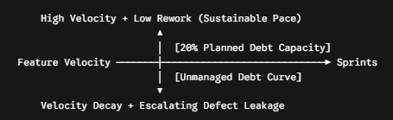
Balancing Feature Delivery with Technical Debt Repayment
Technical debt is the implied cost of additional rework caused by choosing an expedient, short-term solution over a well-architected approach. Left unmanaged, it creates a "debt death spiral" where team velocity drops to near zero as developers spend sprints firefighting regressions.

Slide 32


Balancing Feature Delivery with Technical Debt Repayment
Making Debt Visible: Technical debt cannot stay hidden in code comments. It must be refactored into quantifiable backlog items (e.g., "Refactor legacy payment gateway adapter to cut transaction failure rate").
Capacity Budgeting Rule: Healthy Agile engineering organizations allocate a dedicated baseline (typically 15% to 20% of team capacity) each sprint toward refactoring, dependency updates, and automated test coverage.
CMMI Level 4/5 Alignment: Quantifying debt aligns with Measurement and Analysis (MA) and Causal Analysis and Resolution (CAR). If defect injection rates spike, the PM correlates this trend to debt-heavy modules and justifies technical debt repayment sprints using statistical performance data.

Slide 33

Cross-Functional Team Collaboration

Slide 34
Aligning Engineering, Design, and QA Resources
In high-performing SDLC setups, Engineering, Design, and QA operate as a unified trio rather than siloed assembly-line phases:
The "Three Amigos" Discipline: Before a user story enters a sprint, the Product Owner/Designer (specifying behavior), Developer (specifying technical feasibility), and QA Specialist (specifying validation edge cases) review the story together. This guarantees that requirements are feasible, design components are reusable, and test cases are mapped before coding begins.
Dual-Track Agile: Product Discovery (Design and prototyping) runs one to two sprints ahead of Product Delivery (Engineering and automated QA). This prevents engineers from sitting idle waiting for Figma files and avoids rushed designs drafted mid-sprint.
CMMI Process Integration: This trio alignment satisfies CMMI Integrated Project Management (IPM) and Product Integration (PI) by validating cross-functional interfaces, dependencies, and handoffs before code commits occur.

Slide 35
Facilitating Effective Communication Channels
Unstructured chat creates context fragmentation, notification fatigue, and lost requirements:
Channel Architecture: Communication must be partitioned intentionally into operational streams (e.g., #dev-notifications, #qa-triage), ceremony streams (e.g., #daily-standup-async), and strategic channels (e.g., #product-releases).
Asynchronous vs. Synchronous Operating Agreements: Routine status updates, code review requests, and non-blocking documentation belong in async channels (Confluence, Jira threads, recorded video walk-throughs). Synchronous meetings (MS Teams) are strictly reserved for unblocking dependencies, collaborative architecture spikes, and retrospective problem-solving.
Auditable Communication: Under CMMI Level 3, critical architectural decisions, scope approvals, and process deviations cannot live in ephemeral 1:1 chat DMs; they must be surfaced and linked to Confluence decision registers or Jira issues.

Slide 36
Fostering a Culture of Accountability and Psychological Safety
High maturity requires balancing rigorous accountability with high psychological safety:
Psychological Safety as a Quality Precondition: If engineers fear admitting mistakes or surfacing delivery bottlenecks, defects are concealed until release gates. CMMI higher maturity (Causal Analysis and Resolution - CAR) relies entirely on blameless transparency to find root causes in system processes rather than assigning individual fault.
Blameless Post-Mortems: When incidents occur, teams investigate what systemic safeguards failed (e.g., missing CI/CD lint check, ambiguous acceptance criteria) rather than who typed the line of code.
Empirical Accountability: Accountability is maintained through transparent commitments to the Sprint Goal, adherence to the team's working agreements, and shared ownership of the Definition of Done (DoD).

Slide 37
Managing Stakeholder Expectations and Feedback Loops
Misalignment between engineering teams and business stakeholders typically stems from differing lexicons and opaque progress tracking:
Outcome-Based vs. Output-Based Reporting: Modern PMs guide stakeholders away from tracking lines of code or raw hours worked. Instead, progress is framed around working software milestones, business value increments, and risk burndown metrics.
Cadenced Feedback Loops: Stakeholders must have scheduled, low-friction review windows (e.g., bi-weekly Sprint Reviews, pre-release staging walk-throughs) to avoid disruptive, mid-sprint scope changes.
The "Iron Triangle" Reality: PMs enforce honest governance: if stakeholders demand new scope mid-release, the trade-off must be immediately transparent—either delivery dates shift, low-priority backlog scope is swapped out, or additional resources are factored into future sprints (Requirements Management - REQM).

Slide 38
Release Planning and Delivery
(CI/CD Overview)

Slide 39
Understanding Continuous Integration and Deployment Flows
Continuous Integration (CI): Developers commit code to a shared mainline multiple times a day. Each commit triggers an automated pipeline that builds the application, runs unit and integration test suites, and conducts static code analysis (e.g., SonarQube). Under CMMI Verification (VER), CI automates peer-level quality gates, preventing regression before code is merged.
Continuous Delivery vs. Continuous Deployment (CD): In Continuous Delivery, code automatically passes through automated testing environments (staging, performance, security) and remains in a deployable state, requiring an explicit approval to push to production. In Continuous Deployment, every change that clears the automated test suite pushes to production automatically. For CMMI Level 3–4 organizations, Continuous Delivery is often preferred because it preserves auditable release stage-gate sign-offs.

Slide 40
Managing Build Artifacts, Versions, and Release Branches
In disciplined delivery models, source code management directly satisfies CMMI Configuration Management (CM):
Branching Strategies: Teams employ Trunk-Based Development (short-lived feature branches merged frequently into main) or GitFlow (structured branches: feature/*, develop, release/*, hotfix/*). Trunk-based development reduces merge conflicts and supports CI/CD speed, while release branches provide stable freeze points for regression validation.
Semantic Versioning (SemVer): Releases follow the standardized structure MAJOR.MINOR.PATCH:
  MAJOR: Breaking, incompatible API changes.
  MINOR: Backward-compatible new functionality.
  PATCH: Backward-compatible bug fixes and security hotfixes.
Immutable Build Artifacts: Under CMMI Level 3, a binary compiled for testing must be the exact same artifact deployed to production. Binaries (e.g., Docker images, JAR files) are tagged, cryptographically hashed, and stored in central artifact repositories (such as Nexus, Artifactory, or AWS ECR) to guarantee end-to-end traceability from Jira issue to production package.

Slide 41
Coordinating Blue-Green, Beta, and Canary Deployments
Modern deployment strategies eliminate traditional "maintenance window" downtime and drastically reduce operational release risk (Risk Management - RSKM):
Blue-Green Deployment: Two identical production environments run side by side. Environment Blue serves active user traffic. Environment Green hosts the newly deployed version for live smoke testing. Once verified, the router/load balancer instantly flips traffic from Blue to Green. Rollback is near-instantaneous: simply switch the router back to Blue if errors spike.
Canary Deployment: The new release is exposed to a tiny subset of real production traffic (e.g., 2% to 5%) while the remaining 95% stays on the stable baseline. Observability tools monitor error rates, latency, and CPU usage. If metrics stay healthy, traffic scales incrementally (10%, 25%, 50%, 100%).
Beta Deployments & Feature Flags: Beta deployments route targeted opt-in users or specific demographics to new functionality via runtime configuration toggles (Feature Flags), decoupling code deployment from business feature release.

Slide 42
Quality Assurance & UAT

Slide 43

Integrating QA Early to
Reduce Defect Resolution Costs
Under traditional models, QA operates downstream at the tail end of delivery, resulting in expensive rework, delayed releases, and high regression rates. By integrating QA into backlog grooming and design phases, teams practice defect prevention rather than defect detection.
The Cost-to-Fix Curve: A defect caught during requirements derivation costs a fraction to address compared to one identified during system integration or post-release operations.
Test-Driven & Behavior-Driven Alignment (TDD/BDD): QA works with developers before coding begins to define test specifications and acceptance criteria.
CMMI Verification (VER): Level 3 requires peer reviews and verification of intermediate work products (designs, user stories, architecture spikes), ensuring verification is not treated as a single post-build testing phase.

Slide 44
Managing the User Acceptance Testing (UAT) Phase
While system testing proves the software works according to technical specifications, UAT proves the software solves the actual business problem in real-world scenarios.
CMMI Validation (VAL): CMMI distinguishes between Verification ("Did we build the system right?") and Validation ("Did we build the right system?"). UAT is the primary vehicle for Validation.
Managing Business Users: End users and business SMEs often struggle with unstructured testing. Project managers must supply curated test scripts, real-world business transaction scenarios, sanitized production-like test data, and dedicated timeboxes to prevent UAT from stalling release timelines.
UAT Exit Criteria: Sign-off requires meeting explicit, contractually binding conditions: zero open Severity 1/2 defects, 100% execution of critical business journeys, and formal sign-offs logged in the configuration audit record.

Slide 45
Tracking Bugs, Severities, and Triage Processes
Defect management requires standardized taxonomies and rapid resolution governance:
Severity vs. Priority:
  Severity: Technical and operational impact of the bug on the system (e.g., Sev 1 = System Crash/Data Loss; Sev 4 = Cosmetic/Typo).
  Priority: Business urgency of the fix relative to deadlines and customer commitments (e.g., a misspelled company logo on the login page is Low Severity, but High Priority).
Defect Triage Cadence: Daily or bi-weekly triage meetings comprising the PM, QA Lead, Dev Lead, and Product Owner review new defects to validate reproducibility, assign severity/priority, and decide whether to fix immediately, defer to the next sprint, or reject as working as designed.
CMMI Causal Analysis (CAR): High-maturity organizations do not merely close bugs; they categorize defect root causes (e.g., ambiguous requirement, missing regression test, environment drift) to adjust upstream engineering processes.

Slide 46
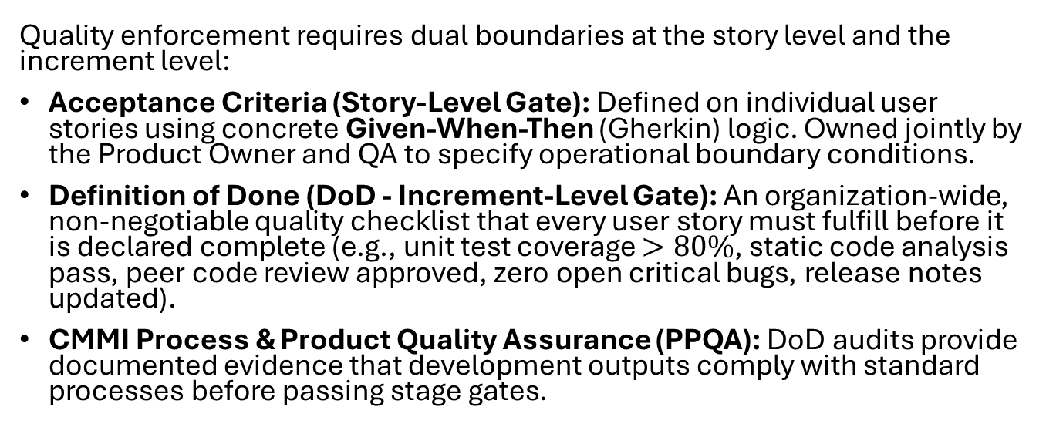
Establishing Clear Acceptance Criteria and Definition of Done (DoD)
Quality enforcement requires dual boundaries at the story level and the increment level:
Acceptance Criteria (Story-Level Gate): Defined on individual user stories using concrete Given-When-Then (Gherkin) logic. Owned jointly by the Product Owner and QA to specify operational boundary conditions.
Definition of Done (DoD - Increment-Level Gate): An organization-wide, non-negotiable quality checklist that every user story must fulfill before it is declared complete (e.g., unit test coverage $>80\%$, static code analysis pass, peer code review approved, zero open critical bugs, release notes updated).
CMMI Process & Product Quality Assurance (PPQA): DoD audits provide documented evidence that development outputs comply with standard processes before passing stage gates.

Slide 47

Metrics, Reporting, and Dashboards

Slide 48

Configuring Actionable Project Dashboards in Jira
Project dashboards in an Agile + CMMI environment replace static status presentations with real-time, audit-ready operational telemetry:
The "One-Pane-of-Glass" Principle: An effective dashboard answers three fundamental questions within five seconds: Are we on track to hit the commitment? Where are the bottlenecks? What unmitigated risks threaten delivery?
Role-Tailored Information Architecture: Dashboards must serve two distinct audiences without data distortion:
  Team/Tactical View: Active sprint health, unassigned tickets, blockers/impediments, open pull requests, and daily defect triage queues.
  Executive/Governance View: Release forecast, epic completion percentages, budget/point burn, and high-severity defect density.
CMMI Measurement and Analysis (MA) Alignment: Level 3 and 4 organizations mandate that metrics directly align with organizational business objectives. Jira gadget filters (using precise JQL) ensure that metric baselines, defect containment rates, and cycle times are captured systematically without manual spreadsheets.

Slide 49
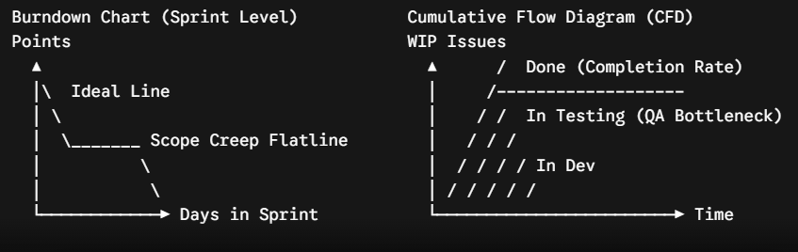
Analyzing Burndown, Burnup, and Cumulative Flow Diagrams
Visual charts reveal systemic delivery dysfunction, scope volatility, and workflow bottlenecks that simple velocity numbers conceal.

Slide 50
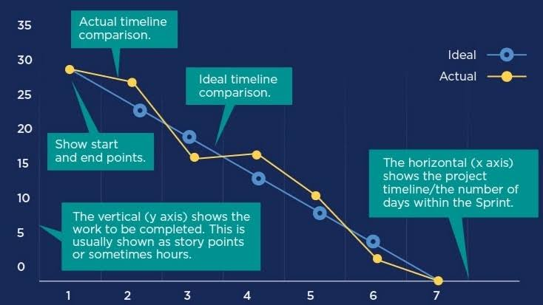
Burndown Chart

Slide 51
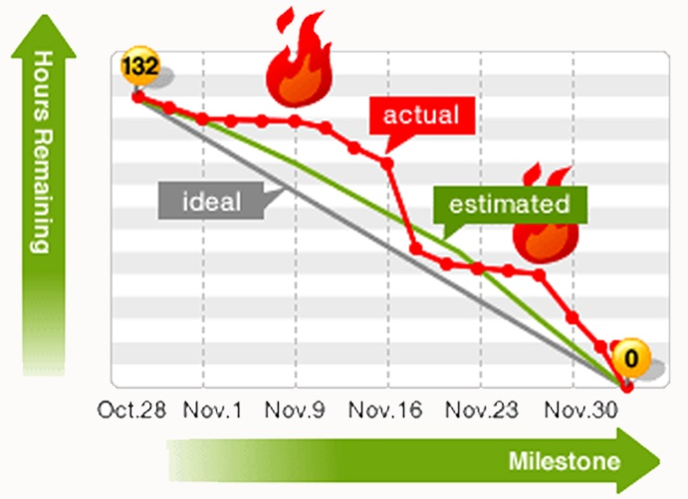
Burndown Chart

Slide 52
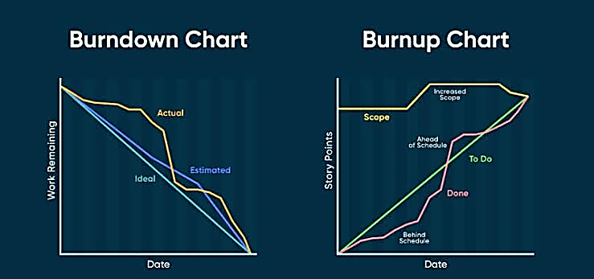
Burnup Chart

Slide 53
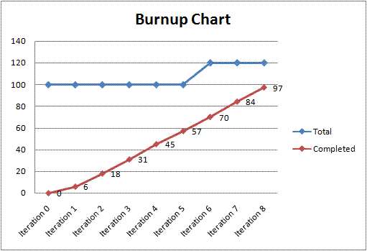
Burnup Chart

Slide 54
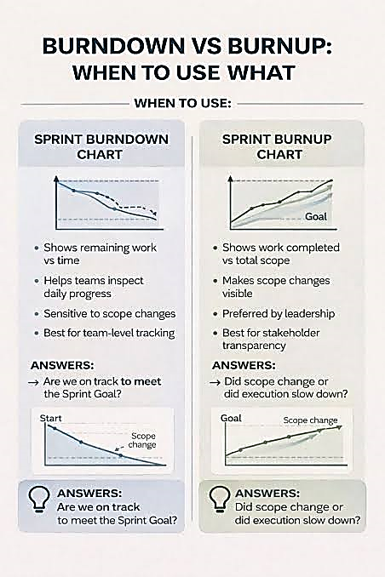

Slide 55
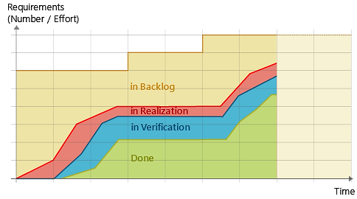
Cumulative Flow Diagram

Slide 56
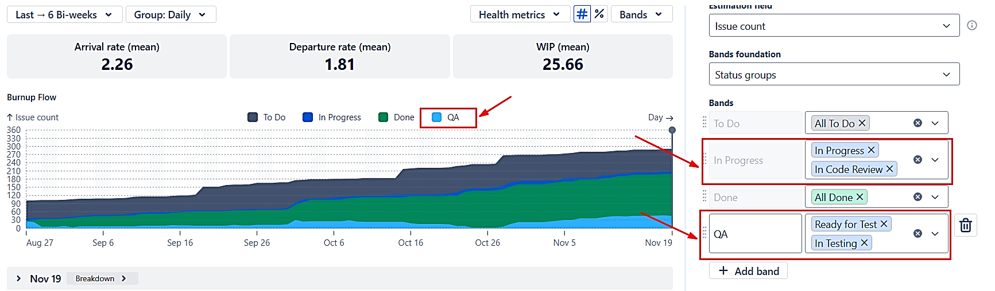
Cumulative Flow Diagram

Slide 57
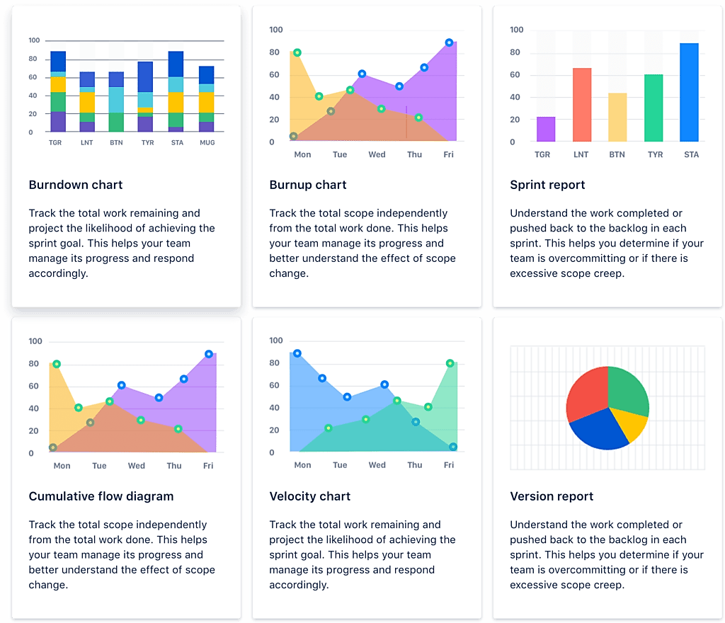

Slide 59
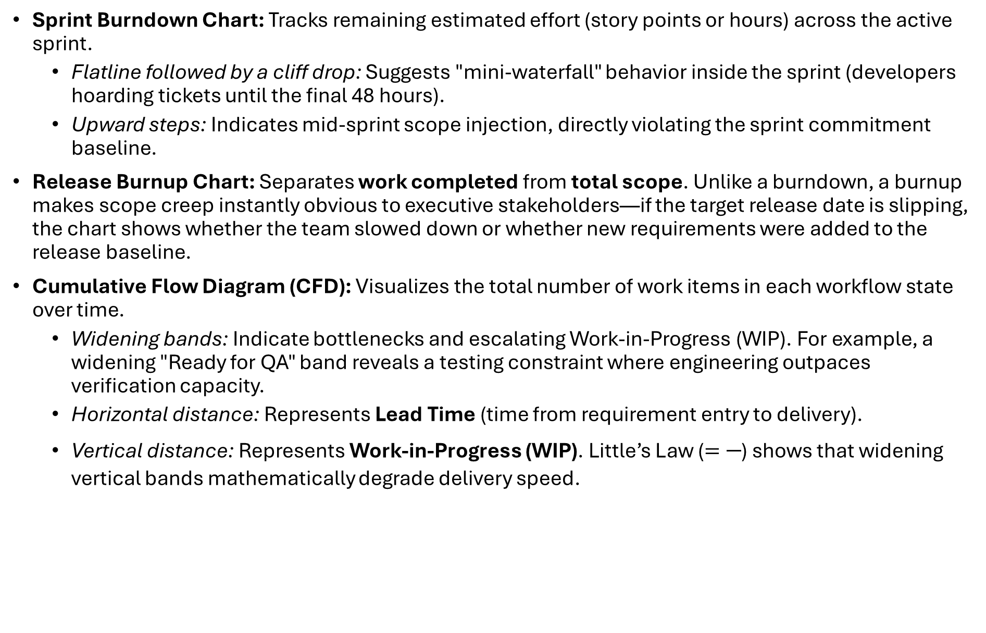
Analyzing Burndown, Burnup, and Cumulative Flow Diagrams
Sprint Burndown Chart: Tracks remaining estimated effort (story points or hours) across the active sprint.
  Flatline followed by a cliff drop: Suggests "mini-waterfall" behavior inside the sprint (developers hoarding tickets until the final 48 hours).
  Upward steps: Indicates mid-sprint scope injection, directly violating the sprint commitment baseline.
Release Burnup Chart: Separates work completed from total scope. Unlike a burndown, a burnup makes scope creep instantly obvious to executive stakeholders—if the target release date is slipping, the chart shows whether the team slowed down or whether new requirements were added to the release baseline.
Cumulative Flow Diagram (CFD): Visualizes the total number of work items in each workflow state over time.
  Widening bands: Indicate bottlenecks and escalating Work-in-Progress (WIP). For example, a widening "Ready for QA" band reveals a testing constraint where engineering outpaces verification capacity.
  Horizontal distance: Represents Lead Time (time from requirement entry to delivery).
  Vertical distance: Represents Work-in-Progress (WIP). Little’s Law ($=\frac{}{}$) shows that widening vertical bands mathematically degrade delivery speed.

Slide 60
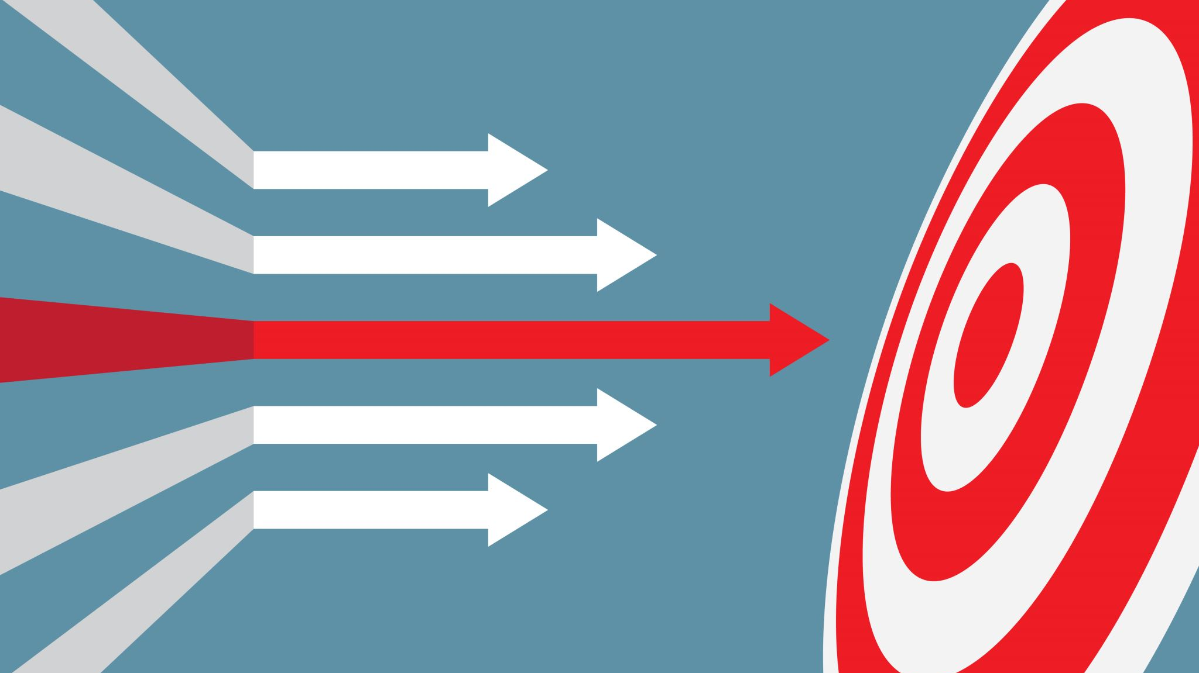
Change Management and Scope Creep

Slide 61

Implementing Formal Change Request and Approval Processes
Agile embraces changing requirements for customer competitive advantage, but unmanaged change destroys project predictability. In an Agile + CMMI environment, change management distinguishes between in-scope backlog refinement (elaborating detail on agreed epics) and structural baseline alterations (adding unbudgeted features, altering architecture, or moving milestone commitments):
CMMI Configuration Management (CM) & Requirements Management (REQM): Level 3 requires that once a release baseline is established, any modification must follow a formal, traceable evaluation path.
The Agile Change Control Board (CCB) Evolution: Instead of monthly, paper-heavy bureaucratic committees, the modern Agile CCB operates as a lightweight, weekly or on-demand triage cadence. Key stakeholders (PM, Product Owner, Lead Architect, Business Sponsor) review formal Engineering Change Proposals (ECPs) or Jira Change Requests.
Audit Trail Automation: Every approved change must update the Requirements Traceability Matrix (RTM) in Jira/Confluence, recording who requested the change, why it was approved, and what downstream test cases and user stories were impacted.

Slide 62
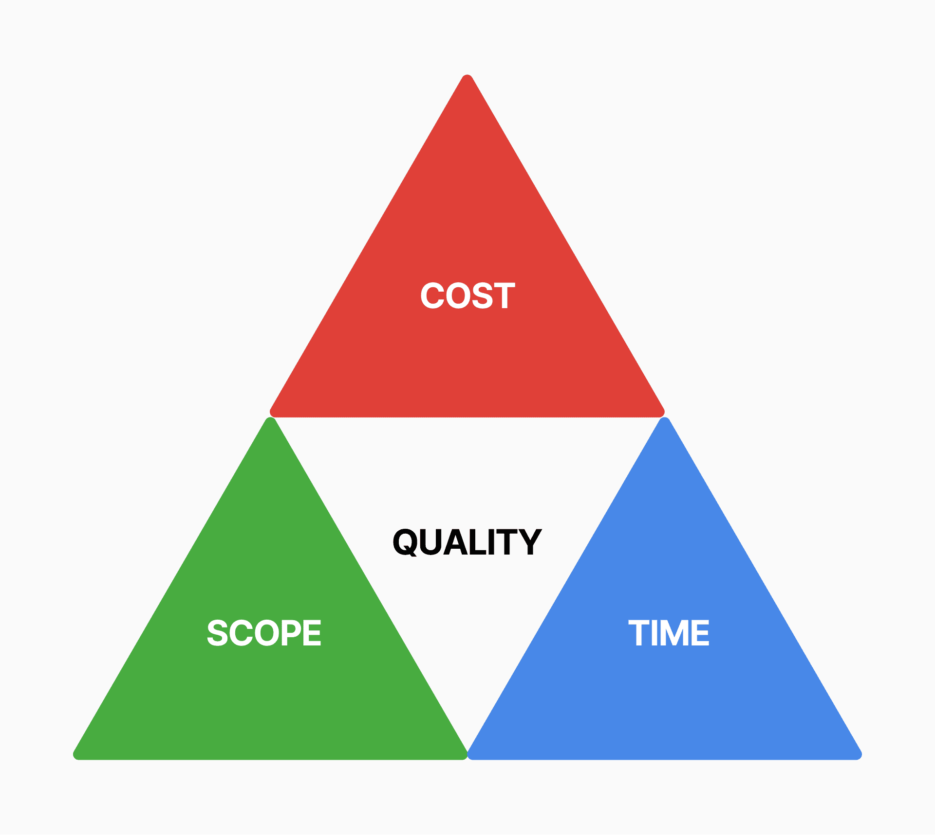
Negotiating Scope Alterations Against Time and Budget Constraints

Slide 63
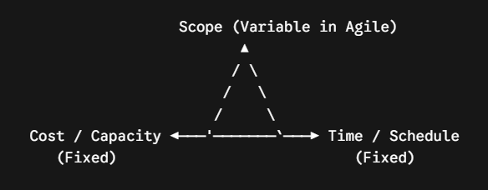
Negotiating Scope Alterations Against Time and Budget Constraints
Project managers prevent scope creep by enforcing the realities of the Project Management Iron Triangle (Scope, Time, Cost/Quality):

Slide 64
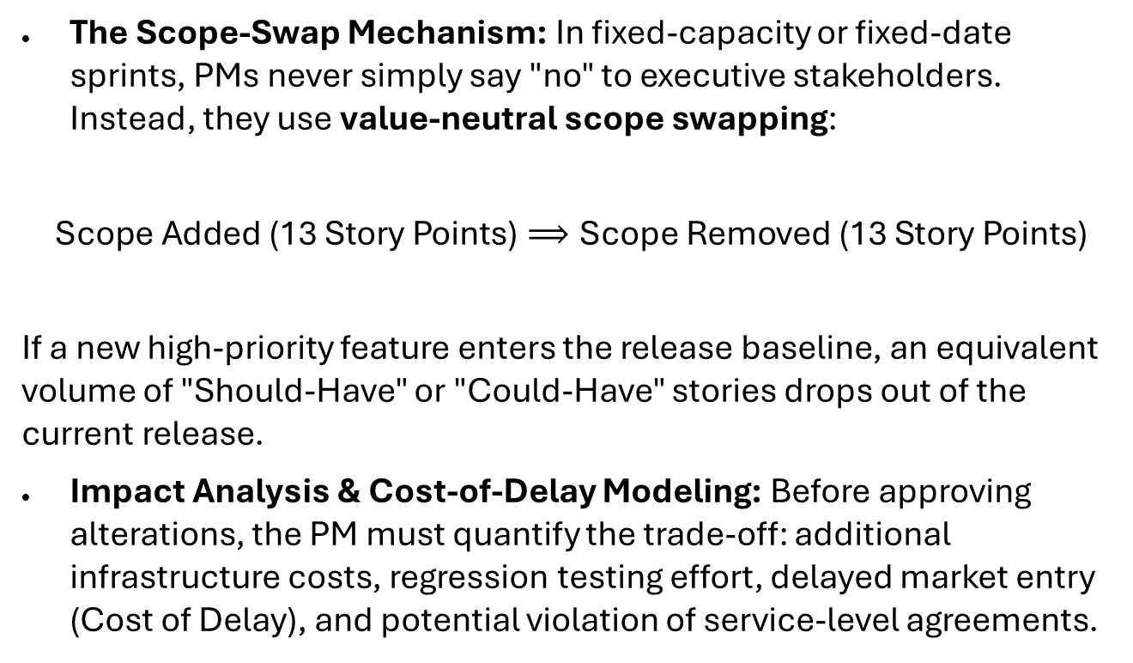
Negotiating Scope Alterations Against Time and Budget Constraints
The Scope-Swap Mechanism: In fixed-capacity or fixed-date sprints, PMs never simply say "no" to executive stakeholders. Instead, they use value-neutral scope swapping:
$$\text{Scope Added (13 Story Points)}⟹\text{Scope Removed (13 Story Points)}$$
If a new high-priority feature enters the release baseline, an equivalent volume of "Should-Have" or "Could-Have" stories drops out of the current release.
Impact Analysis & Cost-of-Delay Modeling: Before approving alterations, the PM must quantify the trade-off: additional infrastructure costs, regression testing effort, delayed market entry (Cost of Delay), and potential violation of service-level agreements.

Slide 65
Maintaining Alignment with Core Business Objectives
Scope creep frequently sneaks in as well-intentioned "gold-plating" (engineers over-engineering architectural solutions or designers adding non-essential micro-interactions).
Strategic Filtering via OKRs and Business Cases: Every epic and major change request must explicitly tie back to a defined Objective and Key Result (OKR) or business driver (e.g., "Reduce onboarding churn by 15%"). If an alteration does not directly advance the targeted metric, it is categorized as non-essential scope.
CMMI Decision Analysis and Resolution (DAR): When high-impact scope deviations arise, PMs facilitate a DAR exercise to evaluate alternatives objectively against predefined criteria (strategic fit, regulatory risk, operational burden) rather than succumbing to the loudest voice in the room.

Slide 66

CMMI in Delivery, Quality, and Governance

Slide 67
Using CMMI Key Process Areas to Strengthen QA, UAT, and Release Management
CMMI Practice Areas (formerly Key Process Areas / KPAs) transform quality assurance and release management from ad hoc, end-of-cycle firefighting into disciplined, institutionalized engineering practices:
Verification (VER) & Validation (VAL) in QA and UAT: Verification focuses on peer reviews and static testing during development ("Did we build the system right?"), while Validation confirms operational effectiveness during UAT ("Did we build the right system?"). Mapping these to sprint cycles ensures that acceptance testing is not an afterthought, but an ongoing verification trail.
Configuration Management (CM) in Release Cycles: Level 3 CM requires strict configuration baseline control. Every build artifact, schema migration, environment config, and release tag must be uniquely identified, versioned, and auditable against Jira user stories and Git commits.
Process and Product Quality Assurance (PPQA): PPQA acts as an objective lens—verifying that teams actually follow agreed-upon processes, that stage gates are respected, and that non-compliance issues are tracked and escalated objectively.

Slide 68
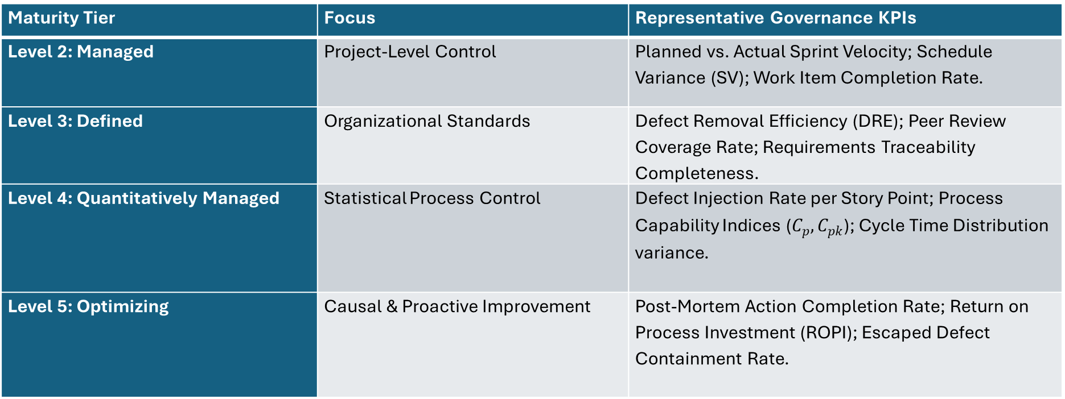
Establishing Measurable KPIs Aligned with Maturity Goals
CMMI organizations use quantitative metrics to guide governance rather than relying on subjective status reports:
Maturity Tier | Focus | Representative Governance KPIs
Level 2: Managed | Project-Level Control | Planned vs. Actual Sprint Velocity; Schedule Variance (SV); Work Item Completion Rate.
Level 3: Defined | Organizational Standards | Defect Removal Efficiency (DRE); Peer Review Coverage Rate; Requirements Traceability Completeness.
Level 4: Quantitatively Managed | Statistical Process Control | Defect Injection Rate per Story Point; Process Capability Indices ($C_{p},C_{pk}$); Cycle Time Distribution variance.
Level 5: Optimizing | Causal & Proactive Improvement | Post-Mortem Action Completion Rate; Return on Process Investment (ROPI); Escaped Defect Containment Rate.

Slide 69
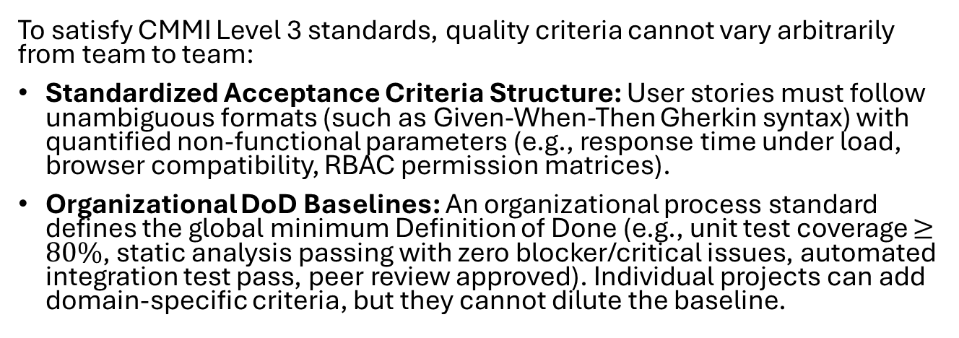
Ensuring Consistent Acceptance Criteria and Definition of Done (DoD)
To satisfy CMMI Level 3 standards, quality criteria cannot vary arbitrarily from team to team:
Standardized Acceptance Criteria Structure: User stories must follow unambiguous formats (such as Given-When-Then Gherkin syntax) with quantified non-functional parameters (e.g., response time under load, browser compatibility, RBAC permission matrices).
Organizational DoD Baselines: An organizational process standard defines the global minimum Definition of Done (e.g., unit test coverage $≥80\%$, static analysis passing with zero blocker/critical issues, automated integration test pass, peer review approved). Individual projects can add domain-specific criteria, but they cannot dilute the baseline.

Slide 70
How CMMI Supports Continuous Improvement and Post-Release Learning Cycles
Continuous improvement under CMMI moves beyond standard Agile retrospectives that often result in untracked wish lists:
Causal Analysis and Resolution (CAR): Mandates that systemic defects, escaped regressions, or process breakdowns undergo structured root-cause analysis (e.g., 5-Whys, Fishbone diagrams).
Institutional Memory via Process Asset Libraries (PAL): Corrective actions are not confined to a single team's sprint notes; they are codified into the organizational asset library (templates, automated CI/CD guardrails, updated checklists) to prevent recurrence across the enterprise.

Slide 71
Preparing Teams for CMMI Appraisals (SCAMPI / Benchmark Appraisals)
Appraisals evaluate whether documented processes match actual daily engineering habits. Standard CMMI appraisals follow a graded progression:
Class C (Informal Quick Check): Interviews or artifact spot-checks to identify initial gaps. Low cost, high-level feedback.
Class B (Pre-Appraisal / Dry Run): Broader scope covering documented evidence and role interviews. Highlights specific process non-compliances before the official audit.
Class A (Formal Benchmark Appraisal): Rigorous, evidence-heavy formal appraisal led by a certified Lead Appraiser. Involves extensive artifact cross-referencing, multi-role interviews, and formal rating determination.
Agile Audit Readiness: Modern teams avoid scrambling for appraisals by generating audit evidence automatically through Jira workflows, automated pull request reviews, and published Confluence governance artifacts.

Slide 72
Post-Release Maintenance and Incident Response

Slide 73

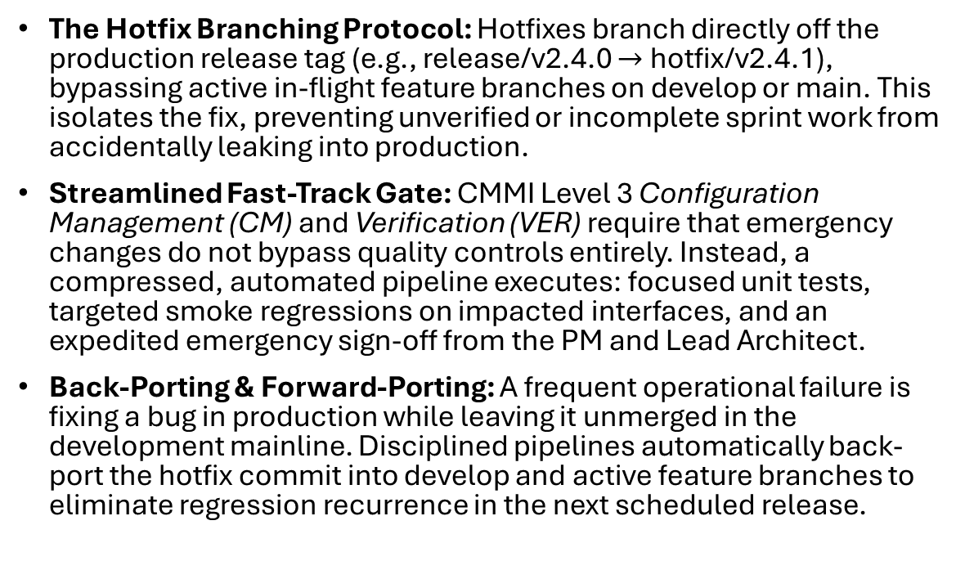
Structuring Hotfixes and Emergency Maintenance Releases
When a critical incident breaches production (e.g., severe data corruption, authentication outage, or security vulnerability), teams cannot wait for the standard two-week sprint cycle. An emergency release framework balances rapid mean-time-to-recovery (MTTR) with CMMI governance integrity:
The Hotfix Branching Protocol: Hotfixes branch directly off the production release tag (e.g., release/v2.4.0 $→$ hotfix/v2.4.1), bypassing active in-flight feature branches on develop or main. This isolates the fix, preventing unverified or incomplete sprint work from accidentally leaking into production.
Streamlined Fast-Track Gate: CMMI Level 3 Configuration Management (CM) and Verification (VER) require that emergency changes do not bypass quality controls entirely. Instead, a compressed, automated pipeline executes: focused unit tests, targeted smoke regressions on impacted interfaces, and an expedited emergency sign-off from the PM and Lead Architect.
Back-Porting & Forward-Porting: A frequent operational failure is fixing a bug in production while leaving it unmerged in the development mainline. Disciplined pipelines automatically back-port the hotfix commit into develop and active feature branches to eliminate regression recurrence in the next scheduled release.

Slide 74
Conducting Post-Incident Reviews (PIR) and Root Cause Analysis
Resolving the immediate production outage restores service, but high-maturity engineering organizations focus on eliminating the systemic weakness that allowed the bug to exist in the first place:
CMMI Causal Analysis and Resolution (CAR): Mandates that organizations investigate critical anomalies, isolate root causes, and systematically adjust processes, tools, or checklists to prevent similar occurrences across the entire portfolio.
Blameless PIR Culture: Post-Incident Reviews focus strictly on system flaws, monitoring gaps, environmental divergence, and process ambiguities rather than human operator error. The guiding premise: human slips are inevitable; resilient systems contain guards and automated recovery mechanisms.
Structured RCA Frameworks:
  5-Whys: Drilling down past superficial symptoms to uncover systemic and organizational root causes.
  Ishikawa (Fishbone) Diagram: Categorizing root causes across People, Process, Tools, Environment, and Specifications.
Institutionalizing the Fix: Every PIR must produce closed-loop deliverables:
  An updated automated test case added to the regression test suite.
  New observability alerts/telemetry to catch degradation earlier.
  Action items logged into the active Jira sprint backlog as high-priority technical debt or process refactoring tasks.

Slide 75
End of Presentation
Thank you!

